Slide 1
Adaptable and adaptive RES envelope solutions to maximize energy harvesting and optimize EU building and district load matching
www.energymatching.eu

Slide 2
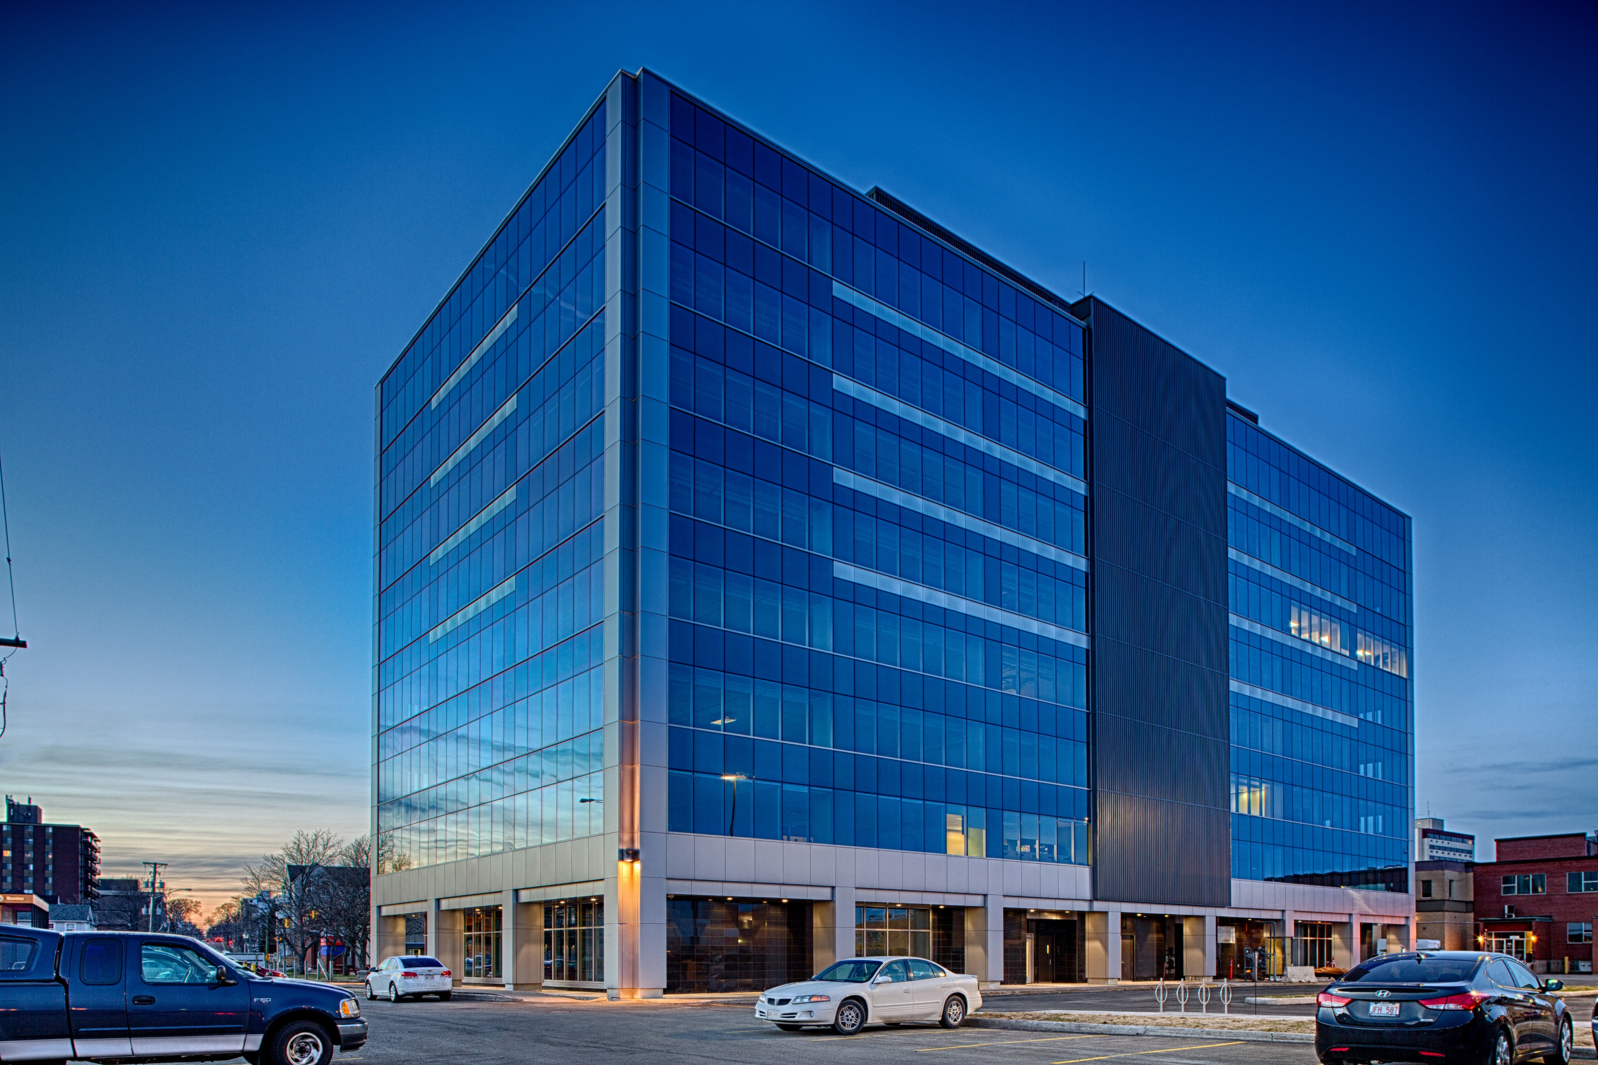








H2020 Project
Consortium: 17 partners
Project Coordinator: EURAC
7 European countries involved
Duration: 54 months
EnergyMatching aims at maximizing the RES (Renewable Energy Sources) harvesting in the built environment by developing and demonstrating cost-effective active building skin solutions as part of an optimised building energy system, being connected into a local energy grid and managed by a district energy hub. Optimised control strategies will be implemented within comprehensive economic rationale balancing objectives and performance targets of both private and public stakeholders.
01/10/2017 – 31/03/2022

Slide 3
Project Background
In order to reach EU goals on energy demand, buildings have to become active elements of the energy network, not only consuming but also producing, storing and supplying energy, transforming the EU energy market.
Residential sector represents most of the built floor surface area among all EU building stock typologies and thus a huge potential to meet the EU policy goals related to NZEB (Nearly Zero Energy Buildings).
EU policy is boosting the reduction of the EU building stock energy demand by 80% by 2050 through renovation.
EnergyMatching will contribute to overcoming these issues by developing active envelope solutions with high aesthetical value and flexibility, and by achieving a higher level of integration between EU residential buildings, their energy systems, the grid and resources.

Slide 4
Project Objectives
1
2
3
Definition of adaptive envelope solutions for energy harvesting at building level
Integration of the energy harvesting solutions into the building and district energy concept
Geoclusterisation of solutions and replication
Developing active adaptive envelope solutions to maximize exploitation of solar energy.
Developing load match aggregation strategies, energy harvesting management systems, control algorithms and optimization tools to maximize the potential for integration and optimisation of renewable energy sources and to connect buildings with various entities like suppliers and distribution system operators through different networks.
Developing tools and strategies to ensure applicability and optimal use of solutions in different geographical areas, tailoring the general solutions for each technology result, and evaluating both technical and economic viability

Slide 5
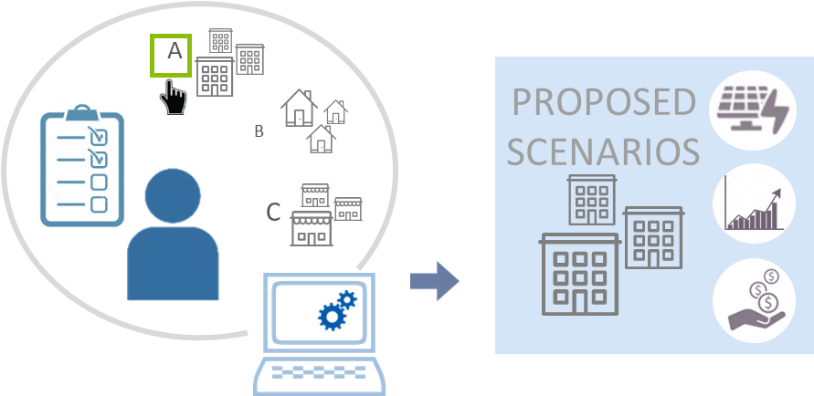
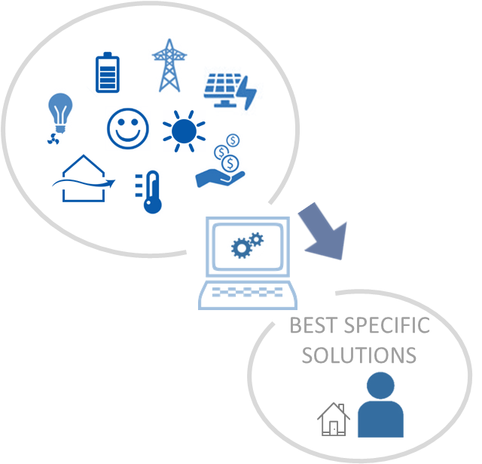
Expected Results
R1
Energy Harvesting business enhancer platform
Web-platform: proposed archetypes of buildings and districts
According to the user input (user context, needs, constraints, etc.), the platform provides suitable examples of optimized buildings and districts + integrated RES, with information about energy production/consumption, business models, visible reliable simulation results, etc.
Methodological framework and business vision
Adaptable and adaptive skin technologies
Building and district energy LAN
R2
Energy Matching optimization tool
Based on simulations of different considered aspects
The results are the best strategies of integration of systems and technologies at building and district level
The user has the possibility to choose which main target to pursue (select the best solution according to the energy demand, or PV production, or daylighting, etc.) in each specific case

Slide 6
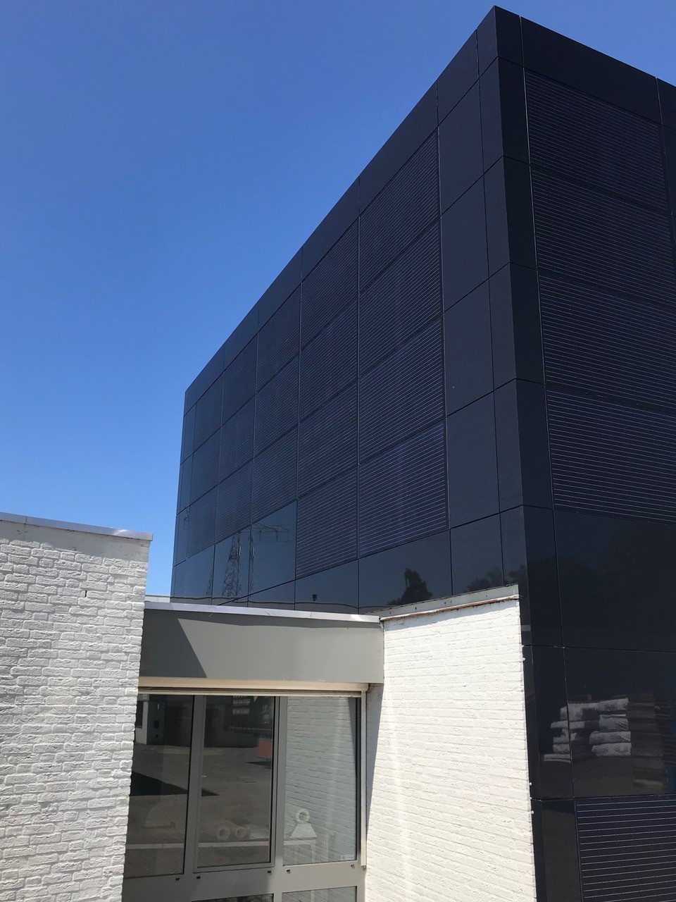
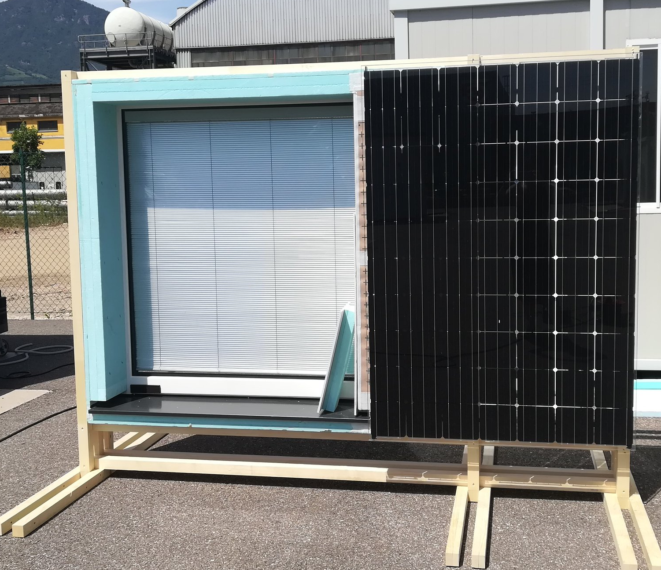
Expected Results
R3
Versatile click&go substructure for different cladding systems
Lightweight substructure
Adaptable to different envelope typologies
Reduced installation time, costs, impact
  Aesthetically appealing
  Easy maintenance
Methodological framework and business vision
Adaptable and adaptive skin technologies
Building and district energy LAN
BIPV combined with traditional façade material thanks to the click&go substructure (Source: TULiPPS)
R4
Solar windows package
Reducing the building energy demand, generating energy and increasing the indoor comfort
Insulated framework
Double or triple glazing system containing a PV module or a motorized shading system
Modular and flexible, easy to maintain
Window block mock-up developed in EnergyMatching

Slide 7
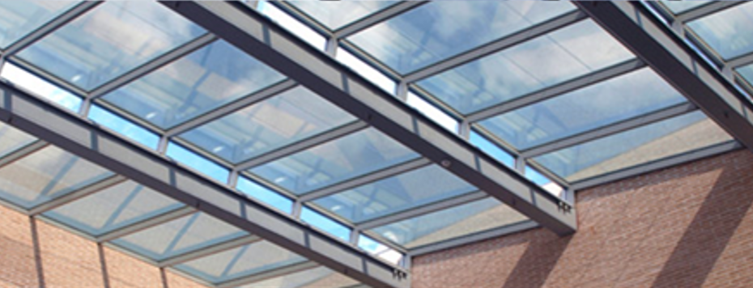
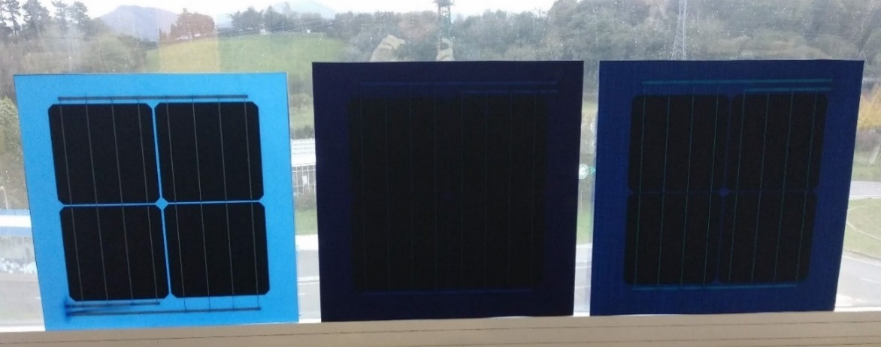
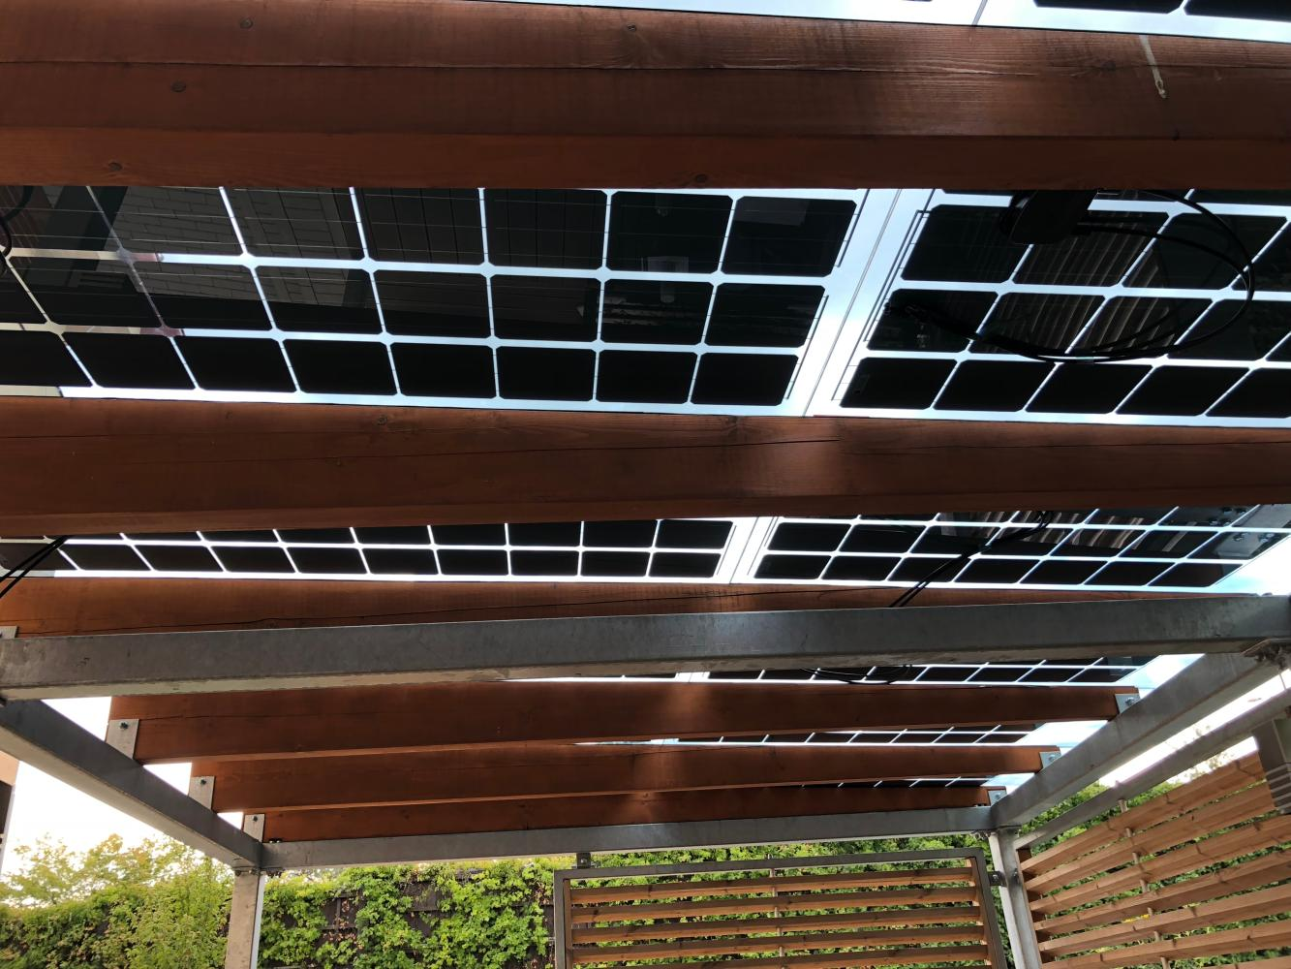
Expected Results
R5
Modular appealing BIPV envelope solutions
Integrated with the click&go substructure
Aesthetically advanced
Flexible (material, shape, size, colour)
Multifunctionality (PV production, building energy demand, internal comfort, etc.)
Methodological framework and business vision
Adaptable and adaptive skin technologies
Building and district energy LAN
BIPV in San Antón Market Project in Madrid (Source: ONYX)
Example of tests performed in EnergyMatching adding small percentages of inks/pastes to transparent resin for achieving appealing composite-based BIPV solutions
BIPV in Private Residence Canopy in Prague (Source: ONYX)

Slide 8
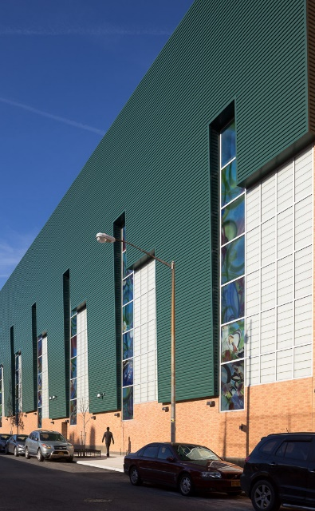
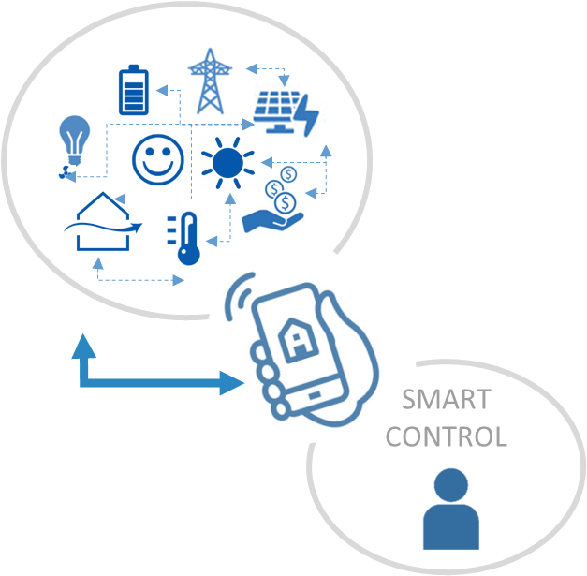
Expected Results
R6
Renewable harvesting package to heat and ventilate
Dual-source electrically-driven heat pump for heating, DHW and cooling
SolarWall for pre-heating
Natural ventilation strategies
Heat recovery ventilation unit
Smart control
Methodological framework and business vision
Adaptable and adaptive skin technologies
Building and district energy LAN
Schematic design and real application of SolarWall technology (Source: SolarWall)
R7
Building and district energy harvesting management system
The energy harvesting technologies and plants are interconnected: power/information exchange between buildings/energy systems
Monitoring data and forecasts, and user information (smart control)
Flexibility between energy production/distribution/consumption optimization

Slide 9
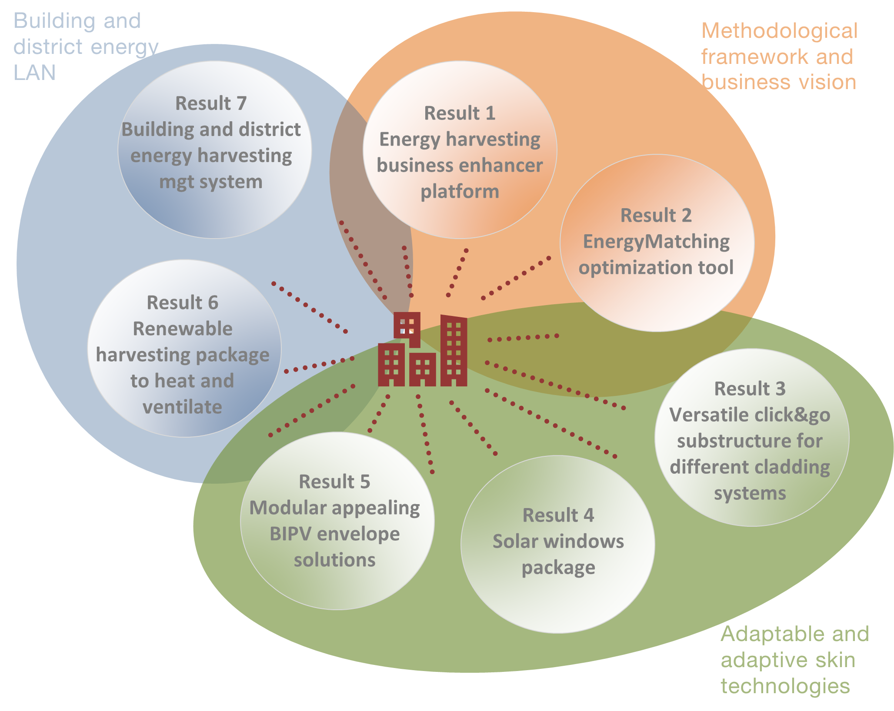
Expected Results

Slide 10
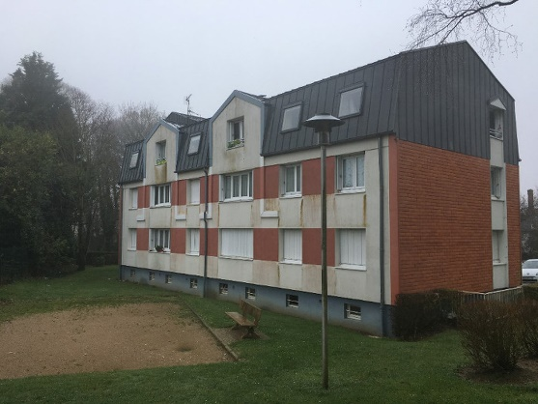
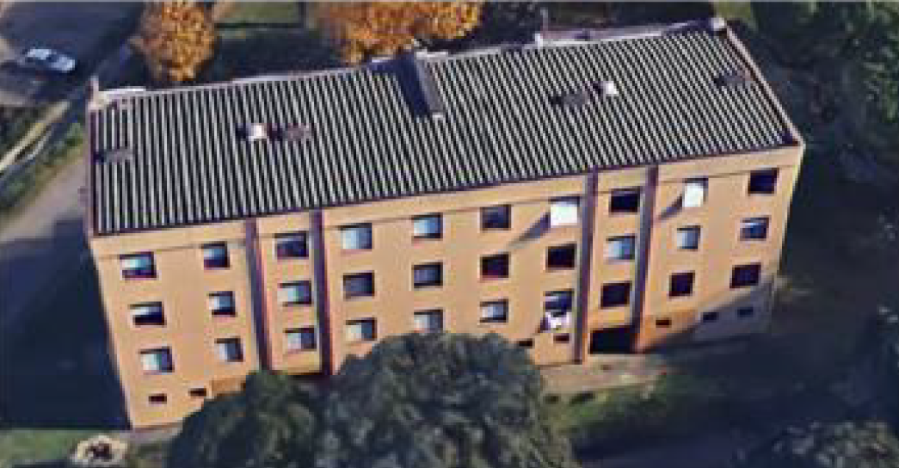
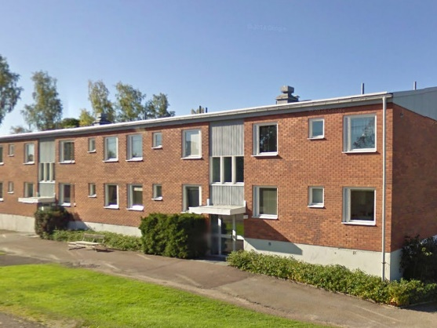



Demo-cases
Solutions will be demonstrated in three demo cases, which have a large replication potential in terms of climatic conditions, legislation and regulation framework, type of ownership, buildings’ architectural features and social-cultural environment.
Multifamily dwelling unit built in 1969 and extended (above the existing building) in 1988. The building includes 22 residential units over 1 basement plus 7 stories combining the first construction and the extension (3 in building A + 4 in building B).
Multifamily dwelling unit built in 1984. The building includes 12 residential units over four floors, plus common areas.
Multifamily dwelling made of three buildings in 1973. The complex includes 53 apartments over 2 floors and a basement.
Demo I
Résidence Emile Hauduc
Saint Aubin Sur Scie, France
Demo II
Comune di Campi Besenzio
Comune di Campi Bisenzio, Italy
Demo III
Ludvika
Ludvika, Sweden
Lot size: 2800 m2
Façade area: 1100 m2
Roof area: 360 m2
Estimated Energy Consumption:
146-175 kWh/m2/year
Lot size: 4488 m2
Façade area: 2146 m2
Roof area: 1750 m2
Estimated Energy Consumption:
170 kWh/m2/year
Lot size: 1643 m2
Façade area: 2146 m2
Roof area: 528 m2
Estimated Energy Consumption:
265 kWh/m2/year

Slide 11
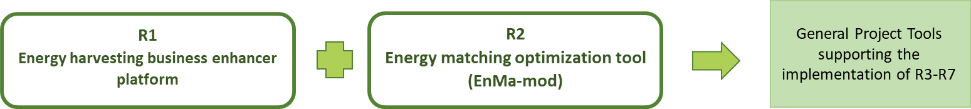
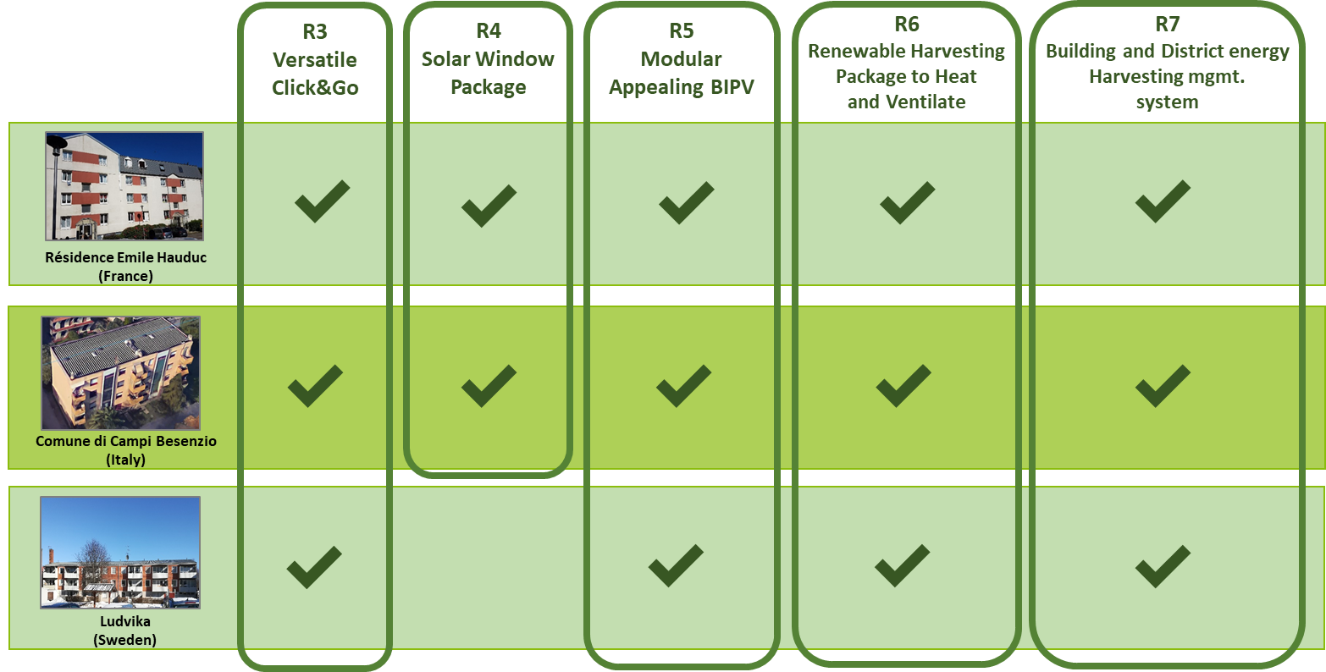




Demonstration of Project Technologies

Slide 12
Demo-cases. Methodology
Establishment of local demo-case working groups
Design process
Construction works
Monitoring of performance & feedback questionnaire
Analysis of information gathered and lesson learnt for REPLICABILITY & MARKET IMPACT
Authorization framework

Slide 13
Expected Impacts
1
Reduced cost of manufacturing, installation and operation of energy harvesting technologies at building and district scale
2
Demonstrated replicability that will result in the acceleration of the integration of RES into EU diverse residential buildings and districts
3
Cost-effective solutions supported by advanced economic and business models for investors
4
Maximisation of RES generation, demand coverage and optimal integration of RES within energy grids
5
Market penetration of effective, modular, robust and easy to integrate energy harvesting solutions
6
Revitalization of the EU construction / energy harvesting sectors and reduction of Greenhouse Gas Emissions
7
Improved IEQ (Indoor Environmental Quality) with optimal control and natural sources exploitation

Slide 14
Organization Scheme
WP5 Exploitation of the results and business models
WP2 EnergyMatching modelling environment and web platform
WP3 Active skin technologies
WP6
Demonstration of the results
MARKET
WP4 Building and district energy LAN system
WP7 Dissemination and Communication
WP1 Management, WP8 Ethics requirements

Slide 15
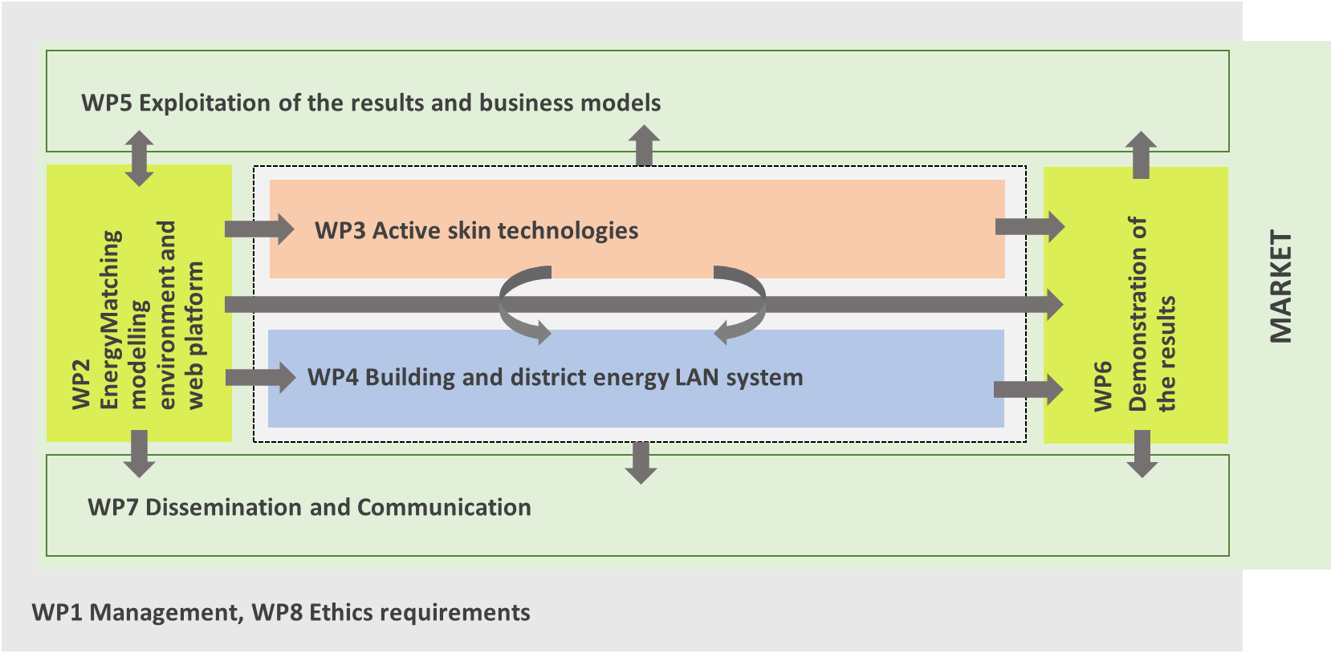
Organization Scheme
WP1 deals with the project management, which includes the administrative, financial and technical-scientific coordination of the activities. WP8 sets out the 'ethics requirements' that the project must comply with.
WP5 aims to draw the path to the market defining a reliable exploitation plan for the replication of the process and the commercialization of the single results, as well as of the whole EnergyMatching approach.
WP2, WP3 and WP4 represent the core of the EnergyMatching project, where the consortium will develop the seven foreseen results. WP2 is focused on EnergyMatching modelling environment and web-based platform (R1 and R2), while in WP3 and WP4 we will develop the technology solutions (R3, R4, R5 in WP3 and R6, R7 in WP4), being supported by WP2 tools.
Tools (WP2), technologies (WP3) and systems (WP4) will be demonstrated in three demo-cases within WP6.
WP7 concerns the communication and dissemination activities during the whole project life. WP7 enables the hugest spread of EnergyMatching outcomes, and of the EnergyMatching concept as a whole, to targeted business stakeholders, decision makers and building owners.

Slide 16
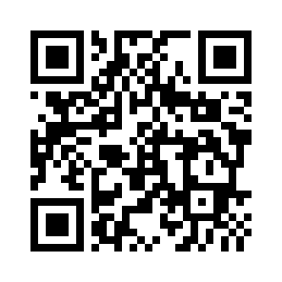



Project Coordinator Contact Details
EnergyMatching Website
Social Media
#EnergyMatching
@EnergyMatching
David Moser:
David.moser@eurac.edu
Laura Maturi:
Laura.maturi@eurac.edu
#EnergyMatching
www.energymatching.eu
Project video here

